Slide 1

Research
Inforum
Integrating Type Operators into the FreeST Programming Language
Paula Lopes
Advisors: Diana Costa, Vasco T. Vasconcelos

Slide 2


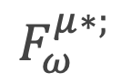
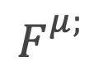
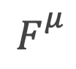
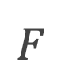
Introduction
$$F_{}^{}$$
$$F_{}^{μ}$$
$$F_{}^{μ;}$$
$$F_{ω}^{μ∗;}$$

Slide 3

Context-free Session Types
Constructor
session type constructors (list)

Slide 4
Context-free Session Types
Table with session type constructors, then add (;) and Skip for context-free.
Example streaming integer trees on channel (maybe another slide)
Notes:
Goal is to move beyond context-free session types by introducing type operators into FreeST.

Slide 5
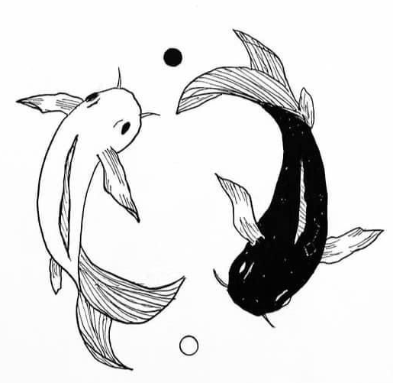
Duality

Slide 6

Kind
Kinds categorize types. A base kind is represented with kind \star, while a higher-order kind is k => k’.
Proper Type
A proper type has a base kind.
Type Operator
A type operator acts upon types to create complex types.

Slide 7
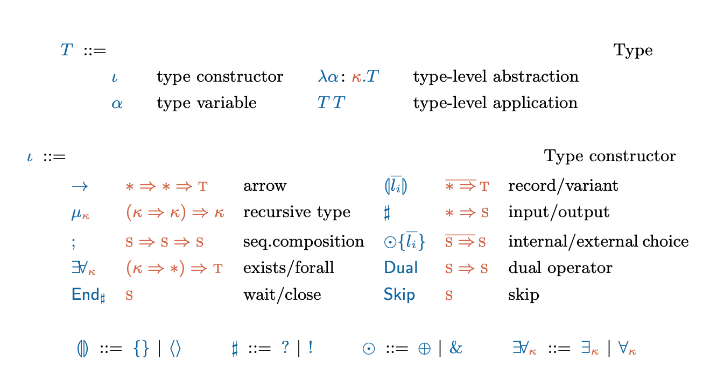

System $F_{ω}^{μ∗;}$
Notes:
Definitions: Kind, proper type, type operator

Slide 8
Not all types are of interest (maybe this slide with example)

Slide 9
Weak Head Normal Form
Show Poças paper rules and add the new proviso for confluence
[Confluence] (maybe a lattice figure)

Slide 10
Normal Form
\TODO
Norm
\TODO

Slide 11
Concepts
Def: normal form ( T whnf)
Def: norm (T norm)
Example of a type that does not normalise (maybe another slide)

Slide 12
Type Formation
Show rules
(but we just saw that some types do not normalise) -> decidability of type formation
Notes:
Type formation rules
Normalization
Recursive types and challenges

Slide 13
Decidability of Type Formation
Def: pre-kinding (maybe a mirror figure, since the rules mirror each other apart from the T U norm)
Example of unsuccessful pre-kind (maybe another slide)
Notes:
If T is pre-kinded, T norm terminates.

Slide 14
Normalisation
Divide the reduction steps in two groups (2 circles figure, one with mu reductions, one with b;D)

Slide 15
Check if T is well-formed
Step 1: determine if T is pre-kinded.
Step 2: determine if T is kinded, which involves determining if all sub-terms of T normalise.

Slide 16
Case of Recursive Types
Show sequence of possible reductions.
If T reduces by R-mu, show the restriction of mu*

Slide 17
Type Equivalence
Example \alpha and \beta are alpha-congruent.
Introduce minimal renaming from Poças (maybe another slide)
Notes:
Two (renamed) types are equivalent, if their grammars are bisimilar.

Slide 18
Grammar
Def of Greibach Normal Form grammar.

Slide 19


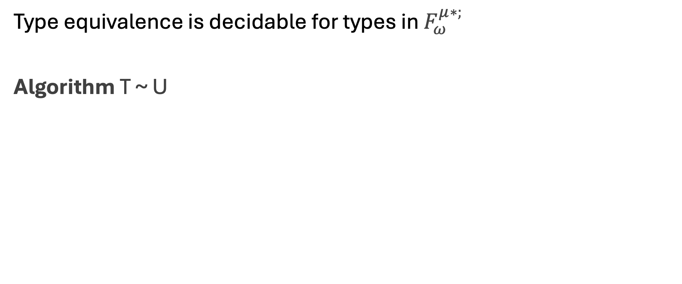
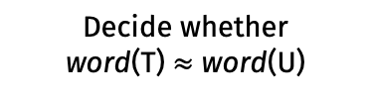
Decidability of type equivalence
Type equivalence is decidable for types in $F_{ω}^{μ∗;}$
Algorithm T ~ U
Compute word(T) and word(U)
Decide whether
word(T) $≈$ word(U)
Notes:
T and U are renamed.

Slide 20
Grammar translation
Show rules and then example (maybe another slide).
Notes:
The application of the word function to T terminates producing a simple grammar (because our well-formed types normalise).

Slide 21
Implementation
Phase 3
….
Phase 2
…
Phase 1
…

Slide 22
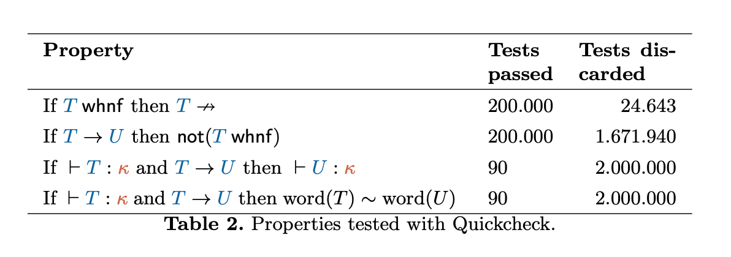
Validation
Syntax -> Generate types -> properties -> run (grafico)
Notes:
Mention that formal proofs are present in Poças work?

Slide 23
Thank you!
Do you have any questions?

